Slide 1
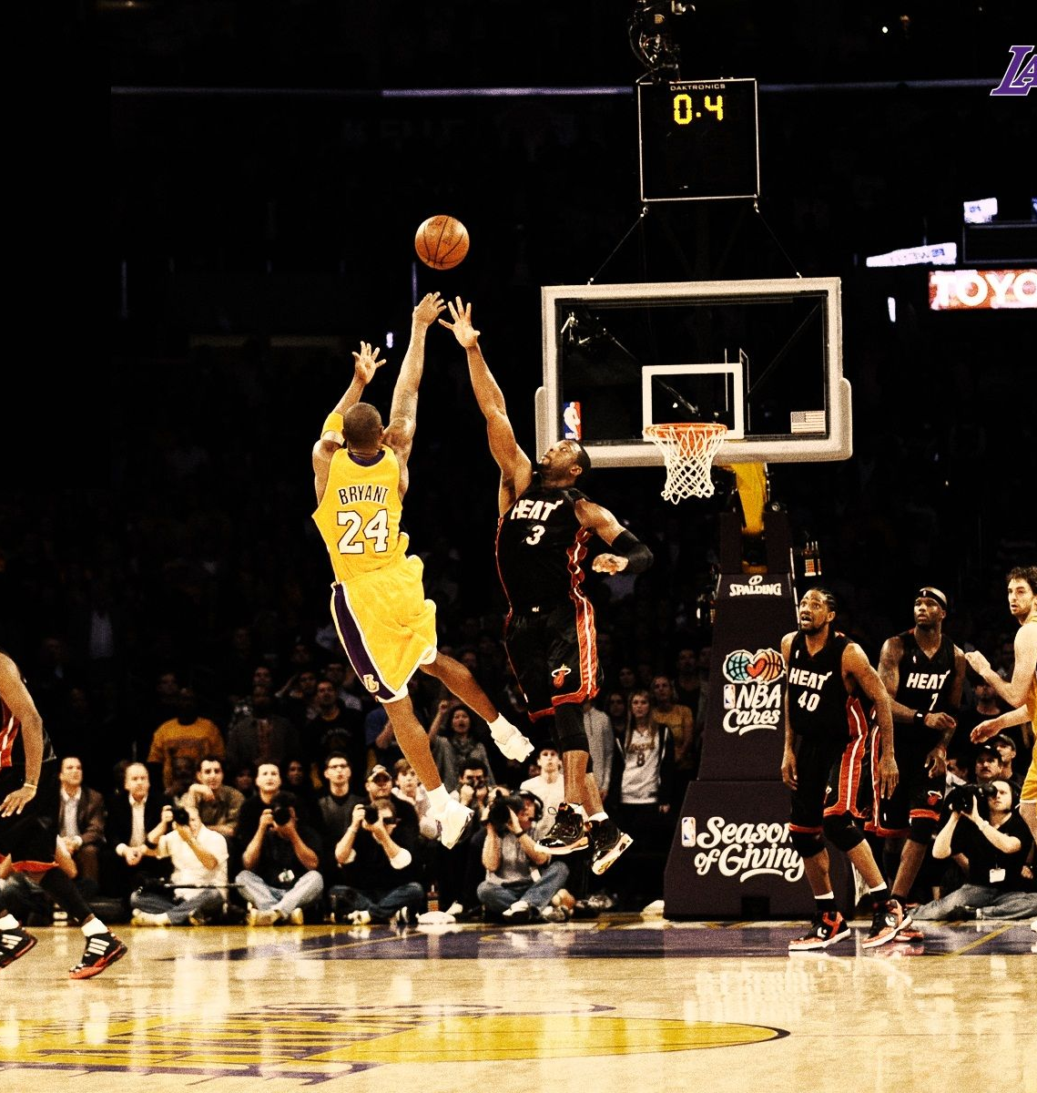

Predicting shot success in the NBA using recurrent neural networks
Thomas Little and Joseph Walbeck
Supervisor: Neil Watson

Slide 2
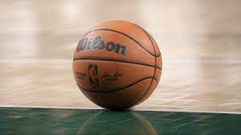
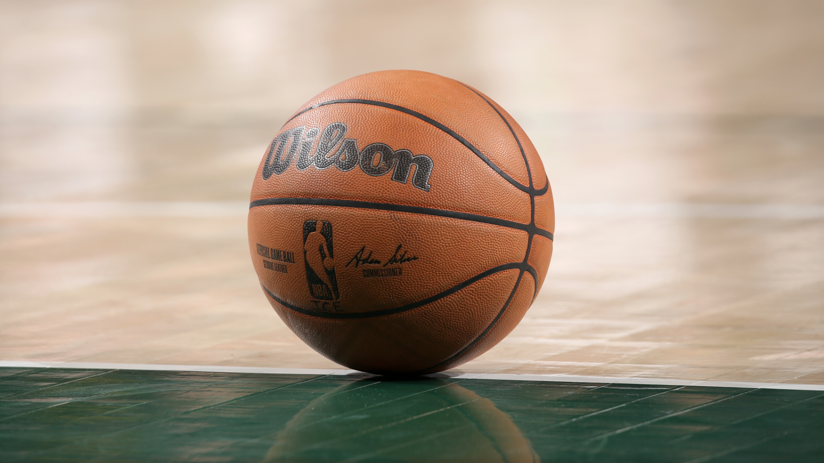
Basketball
Notes:
For those of you unfamiliar with basketball, it is a team-based sport in which the primary goal is to outscore the opposition.
Each team is allowed to field a max of 5 plyers on the court at any time, and there is no limit as to the amount of substitutions that can be made during a game.
Each game consists of 4 12-minute quarters, and in the event of a tie, overtime period, each of 5 minutes in length are played until there is a clear leader at the end of an overtime period.

Slide 3
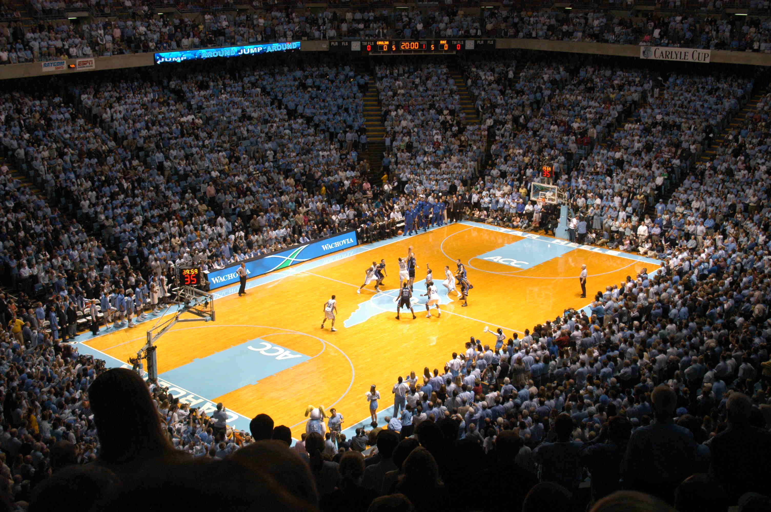
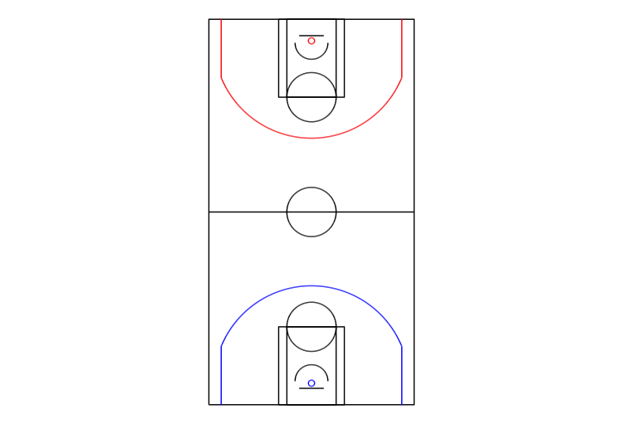
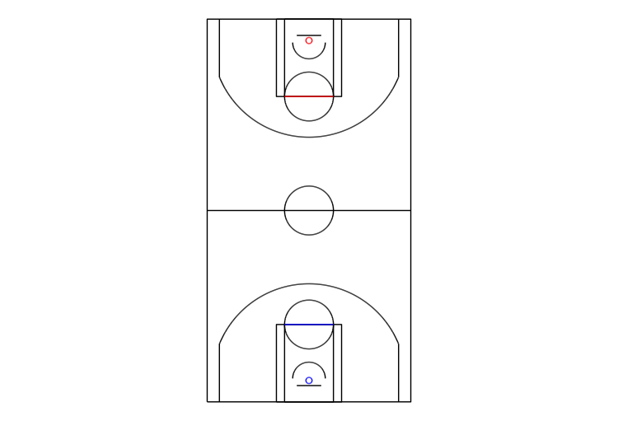
Shot Values
Notes:
Given the title of our topic, “predicting shot success”, it is important to understand how shots are valued.
Turning your attention to the left-hand side of the screen, the blue and red coloured lines represents each teams arc, better known as the 3-point line.
Shots successfully made inside the 3-point line are awarded 2 points and shots made outside are worth 3.
Now turning to the image on the right-hand side of the screen, the red and blue coloured lines represent each team’s free throw line.
Free throws are awarded to players fouled while attempting to take a shot and the number of free throws awarded is based on where the foul takes place, i.e. 2 free throws from within the 3-point line and 3 from outside the 3-point line.
Each successful free throw, taken from behind the above line, is worth 1 point and is taken entirely uncontested by the opposition.

Slide 4
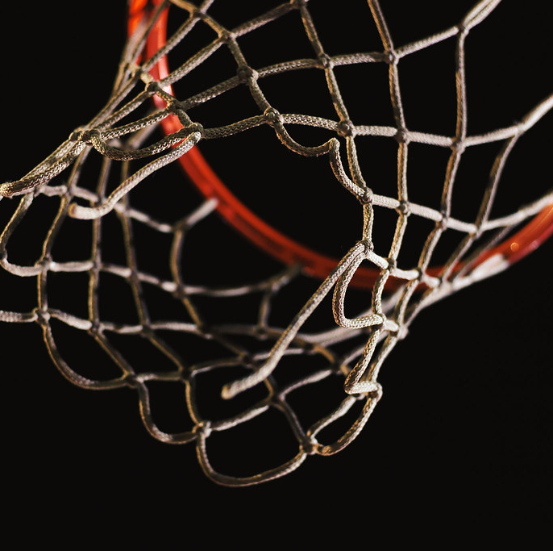
Objectives
Primary Objective
Predicting if a shot will be successful based on information at and before the shot is taken
Secondary Objective
Applying the results to evaluate which teams and players make the best shot-taking decisions
Notes:
Moving onto our objectives, our primary objective is to predict whether a shot will be successful based on player and ball location at and before a shot is taken.
The secondary objective being the application of these results, and using them to evaluate which players and teams make the best shot taking decisions.
Given these objectives, we believe that recurrent neural networks are particularly suited to the problem in that they are designed to model sequential data.

Slide 5
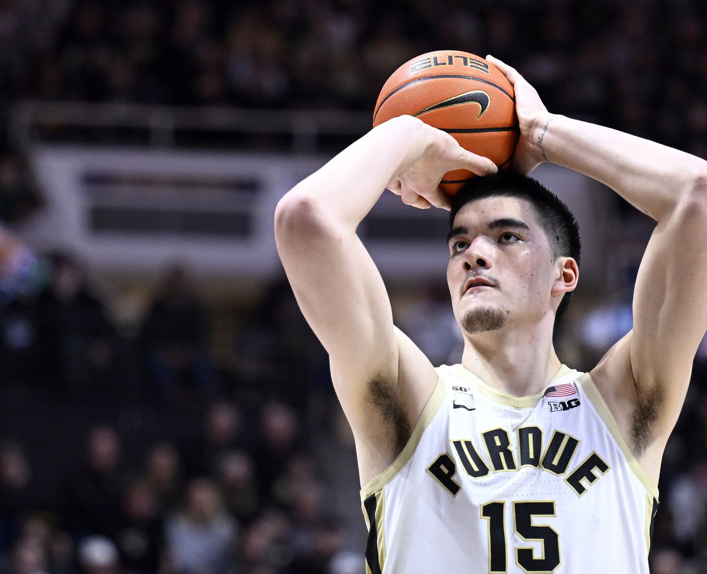

Prior Research
Harmon et al. (2021)
Entitled 'Predicting Shot Making in Basketball Learnt from Adverserial Multiagent Trajectories'
Notes:
The research forming the basis of our topic, conducted by Harmon et al and published in 2021, utilized a combination of Feed-forward and Convolutional neural network algorithms to predict shot success.
We believe however, that given the nature of the data at our disposal (which Tom will explain shortly), that a recurrent neural network would be more effective and a better fit for the problem.

Slide 6
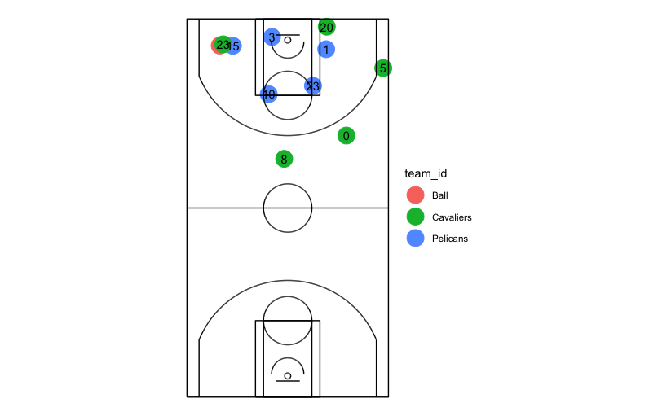
Data
Taken from the 2015-2016 NBA season
Two sources
Spatial
Events
Notes:
2015 – 2016 season
277 games from dec 2015 to feb 2016
For every game
Location data for the players and the ball
Nba's play by play data detailing the events that occur
Shot attempts, whether these are successful or unsuccessful
Who took it
When it happened
Merge datasets

Slide 7
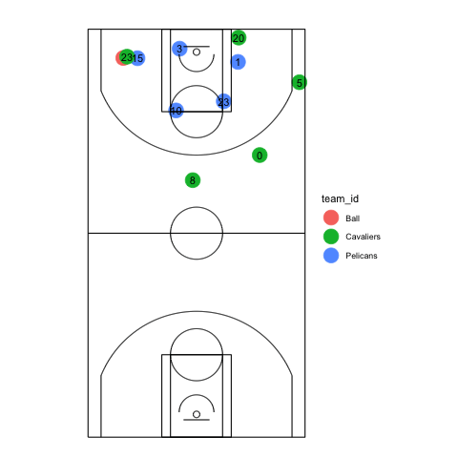
SportVU data
25 hertz
X and Y coordinates of players
X, Y and Z coordinates of the basketball
Notes:
The location data is gathered through the sportVU camera system
6 cameras placed around the court
As you can see in the animation we have created
25 observations per second for every player x and y coordinates
The balls x, y and z coordinates
The data allows us to identify what player the observations belong and what team those players belong to

Slide 8
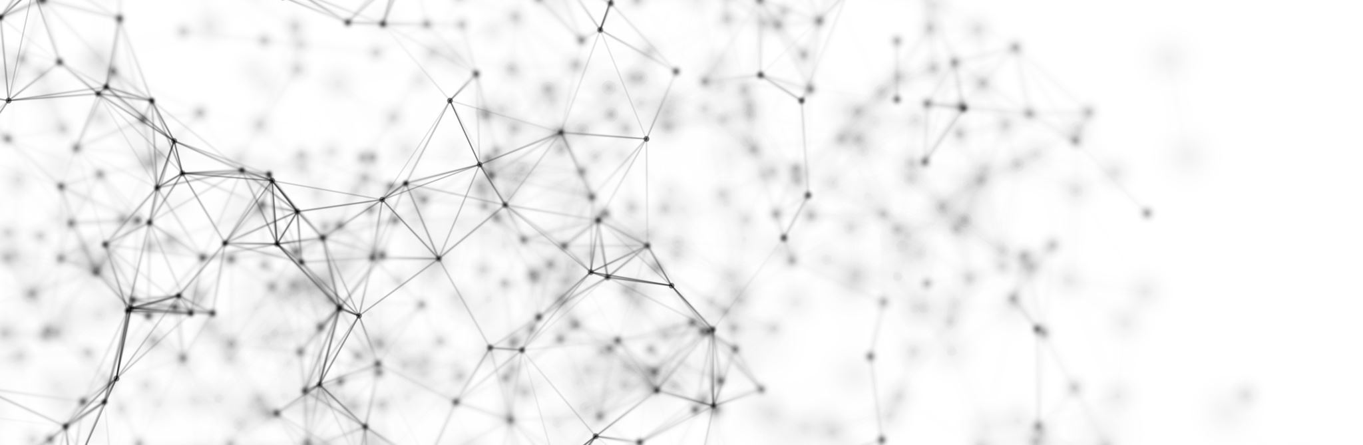
Methodology
Base Model
Logistic Regression Model
Convolutional Neural Networks
Replicate Harmon et al's. (2021) Model
Main model
Recurrent Neural Network
Takes in sequential location data as the input
Notes:
Base models only take in the location information at the time of the shpt
Plan to create features in the data to feed into these base models
Harmon – create an image containing information about the locations the players and the ball for the 5 seconds preceding the shot
Recurrent neural networks suitable for our problem since connections between nodes can create a cycle allowing for sequential data to be fed into the model
Expect to encounter the vanishing gradient problem and will use long short term memory neural networks for this

Slide 9
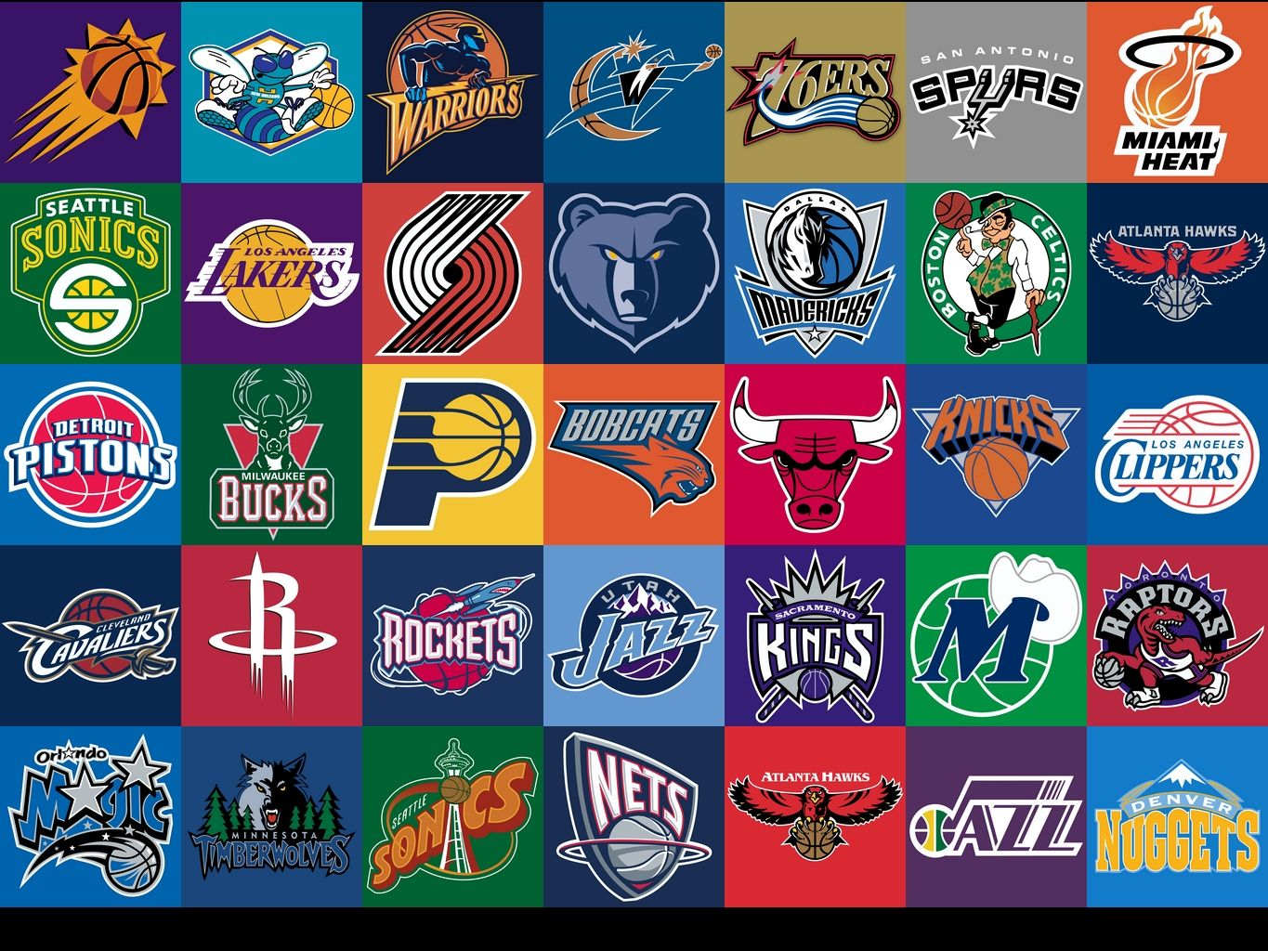

Closing Remarks
Notes:
In closing, we believe that in constructing a statistically accurate and robust model, valuable insight could be offered to basketball teams seeking to use data-driven technology to make better tactical decisions.

Slide 10
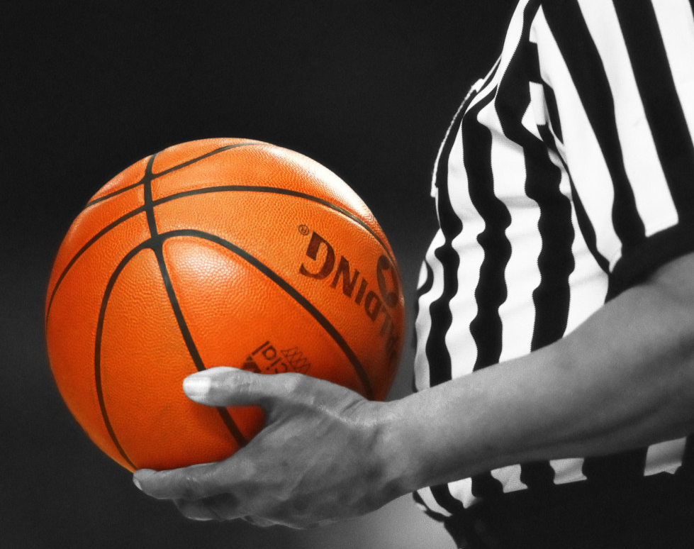
Any Questions?
Notes:
hi

